Slide 1
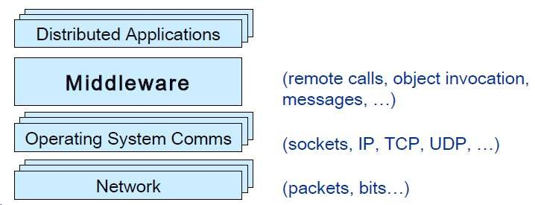
What is Middleware?
Layer between OS and distributed applications
Hides complexity and heterogeneity of distributed system
Bridges gap between low-level OS communications abstractions
and programming
language
Provides common programming abstraction applications
Overview at: http://www.middleware.org
and infrastructure for
distributed

Slide 2
What is Middleware?
Middleware is a software layer that sits between the Operating System (OS) and Distributed Applications.
It hides the complexity and heterogeneity (differences in hardware, OS, protocols) of a distributed system.
Key Roles of Middleware
Abstraction Layer: Provides a high-level programming abstraction so developers don’t need to deal with low-level OS or network details.
Communication Bridge: Connects OS-level communication (like TCP/IP, sockets) with application-level interactions (like remote method calls, object messaging).
Infrastructure Provider: Offers tools and services (e.g., messaging, naming, transactions) to help build distributed applications efficiently.

Slide 3
What is Middleware?
Distributed Applications: Top-level user applications that may be spread across different systems.
Middleware Layer: Offers services like remote procedure calls (RPC), message passing, and object invocation.
Example: CORBA, RPC, RMI, REST, gRPC
Operating System Communications: Manages low-level data transmission via sockets, IP, TCP, UDP.
Network Layer: Responsible for actual data transfer as packets and bits.
Middleware acts as glue for distributed apps.
It simplifies programming in complex environments.
It ensures interoperability, scalability, and transparency in distributed systems.

Slide 4
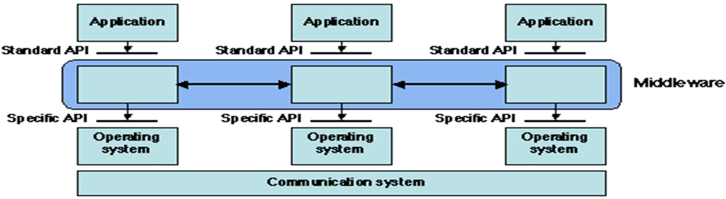
What is Middleware?
“Middleware is the software that connects software components or enterprise applications in a distributed system”.
Examples: Enterprise Application Integration software, telecommunications software, transaction monitors, and messaging-and-queueing software.

Slide 5
What is Middleware?
Real-World Examples
Middleware includes:
Enterprise Application Integration (EAI) software (Connects different enterprise apps like ERP, CRM)
Telecommunication middleware (Supports call routing, messaging, etc.)
Transaction monitors (Ensures consistency in banking transactions)
Messaging and Queueing software (e.g., RabbitMQ, Kafka – used in real-time data pipelines)
Diagram:
Top Layer – Application:
These are end-user or business applications (like a billing system, HR system, etc.).
Middle Layer – Middleware:
Acts as a communication bridge.
Uses Standard APIs to talk to applications.
Uses Specific APIs to communicate with the OS.
Bottom Layer – OS + Communication:
The Operating System handles local system operations.
The Communication System ensures messages/data travel between machines.
Middleware abstracts the OS and network-level complexities, making application communication seamless.

Slide 6
Cont.
Middleware provides support for (some of):
Naming, Location, Service discovery, Replication
Protocol handling, Communication faults, QoS
Synchronization, Concurrency, Transactions, Storage
Access control, Authentication
Middleware dimensions:
– Request/Reply
vs. Asynchronous Messaging vs. Language-independent vs. Standards-based
vs. Large-scale
vs. Loosely-coupled components
Language-specific
Proprietary
Small-scale Tightly-coupled
–

Slide 7
Cont.
Middleware – Features and Dimensions
A. Support Provided by Middleware
Middleware provides services essential for building distributed systems:
Naming, Location, Service Discovery, Replication
Helps applications find each other on the network
Enables data or service copies for reliability and performance
Protocol Handling, Communication Faults, QoS
Manages underlying communication protocols
Handles errors during message delivery
Ensures Quality of Service (QoS), e.g., reliability or timeliness
Synchronization, Concurrency, Transactions, Storage
Ensures correct operation when multiple processes interact
Supports atomic transactions (all-or-nothing operations)
Offers distributed storage support
Access Control, Authentication
Verifies identity of users/services
Controls what each user or service can access

Slide 8
Cont.
Middleware Dimensions (Comparison Points)
Dimension | Types/Variations
Communication Style | Request/Reply ⬄ Asynchronous Messaging
Language Support | Language-Specific ⬄ Language-Independent
Design | Proprietary ⬄ Standards-Based
Deployment Size | Small-Scale ⬄ Large-Scale
Component Coupling | Tightly-Coupled ⬄ Loosely-Coupled Components
Middleware hides complexity in distributed systems.
It provides naming, replication, transactions, and security.
You can classify middleware by communication model, language support, and scalability.

Slide 9
Common Forms of MW
Sockets
Remote Procedure Calls
Distributed Object-Oriented Components (Ex: ORB)
Message Oriented Middleware (Message Queues/Enterprise Message Bus etc.)
Service Oriented Architectures
Web services (Arbitrary / RESTful)
SQL-oriented data access
Embedded middleware
Cloud Computing

Slide 10
Sockets
Socket is an internal endpoint for sending/receiving data within a node on network
Berkeley/POSIX sockets defined API for Inter Process Communication (IPC) within same host (BSD 4.2 – circa 1983)
Early form of Middleware (limited to same host systems)
Windows variant (WinSock) based on BSD Sockets.
Treated similar to files in BSD/POSIX
Maintained in File Descriptor table
Supported protocols
TCP/IP – IPv4, IPv6
UDP

Slide 11

Sockets API
socket —creates a descriptor for use in network communications
connect —connect to a remote peer (client)
write —send outgoing data across a connection
read —acquire incoming data from a connection
close —terminate communication and deallocate a descriptor
bind —bind a local IP address and protocol port to a socket
listen —set the socket listening on the given address and port for connections from the client and set the number of incoming connections from a client (backlog) that will be allowed in the listen queue at any one time
accept —accept the next incoming connection (server)
recv —receive the n ext incoming datagram
recvmsg —receive the next incoming datagram (variation of recv)
recvfrom —receive the next incoming
datagram and record its source endpoint address
send —send an outgoing datagram
sendmsg —send an outgoing datagram (variation of send)
sendto —send an outgoing datagram, usually
to a prerecorded endpoint address
shutdown —terminate a TCP connection in one or both directions
getpeername —after a connection arrives,
obtain the remote machine’s endpoint address from a socket
getsockopt —obtain the current options for a socket
setsockopt —change the options for a socket

Slide 12
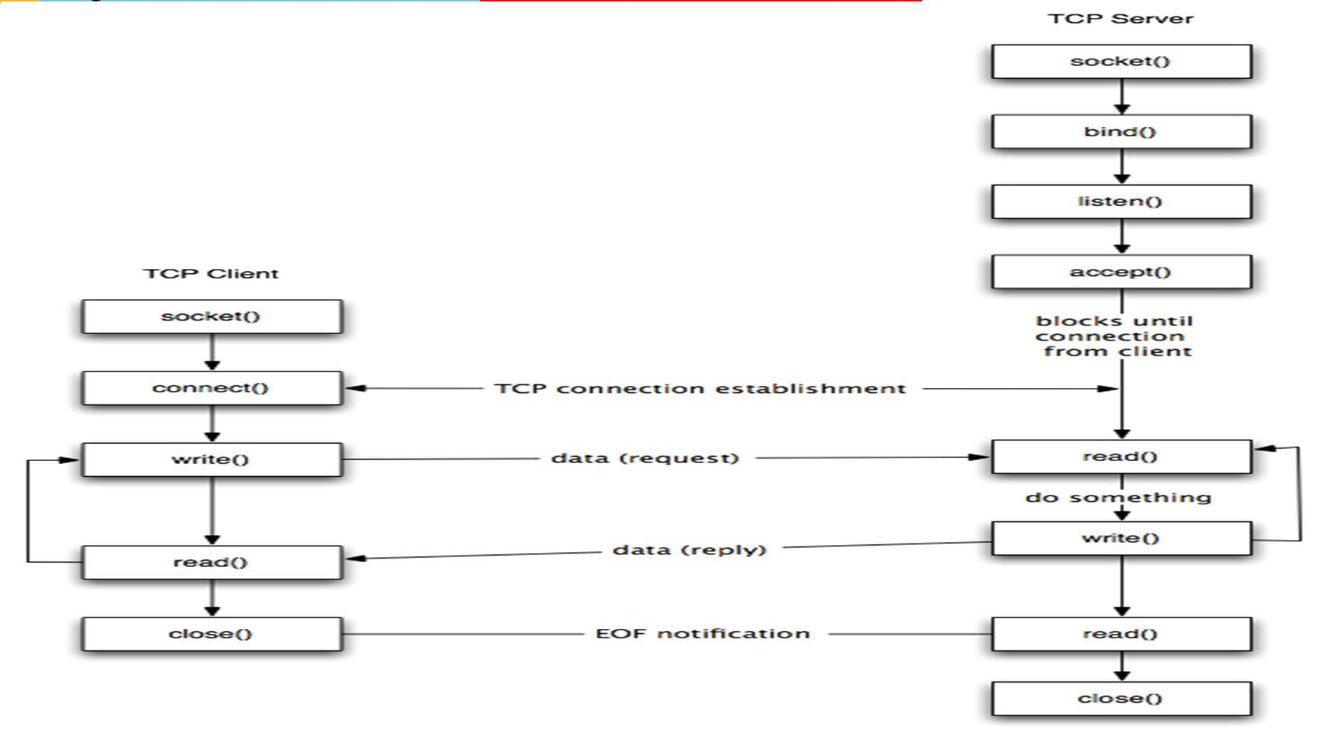


Sockets - Life Cycle
TCP Client – Server example
#Server
server.c
#Client
client.c

Slide 13
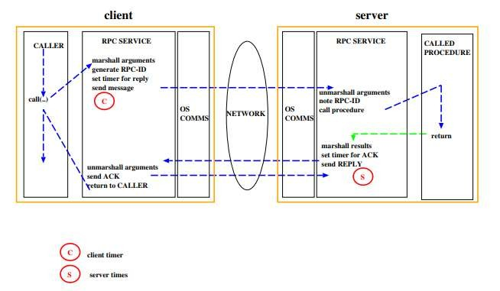
Remote Procedure Call (RPC)
Mask's remote function calls as being local Client/server model
Request/reply paradigm usually implemented with message passing in RPC service
Marshalling of function parameters and return value

Slide 14
Remote Procedure Call (RPC)
Properties of RPC
Language-level pattern of function call
easy to understand for programmer
Synchronous request/reply interaction
natural from a programming language point-of-view matches replies to requests
built in synchronization of requests and replies
Distribution transparency (in the no-failure case)
hides the complexity of a distributed system
Various reliability guarantees
deals with some distributed systems aspects of failure
Failure Modes of RPC
Invocation semantics supported by RPC in the light of : network and/or server congestion, client, network and/or server failure. Note DS independent failure modes
RPC systems differ, many examples, local was Mayflower
May be or at most once( RPC system tries once) Error return – programmer may retry
Exactly once (RPC system retries a few times)
Hard error return – some failure most likely note that “exactly once” cannot be guaranteed

Slide 15
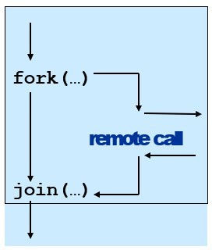
Remote Procedure Call (RPC)
Disadvantages of RPC
Synchronous request/reply interaction
tight coupling between client and server
client may block for a long time if server loaded leads to multi-threaded programming at client
slow/failed clients may delay servers when replying multi-threading essential at servers
Distribution Transparency
Not possible to mask all problems
RPC paradigm is not object-oriented
invoke functions on servers as opposed to methods on objects

Slide 16
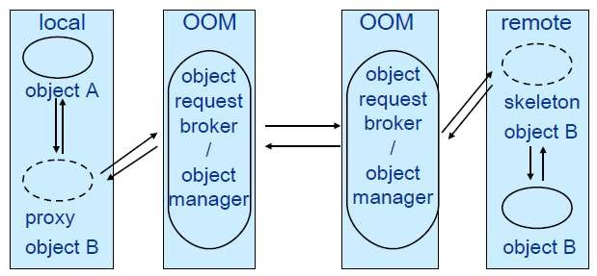
Object-Oriented Middleware (OOM)
Objects can be local or remote
Properties of OOM
Support for object-oriented programming model
objects, methods, interfaces, encapsulation…
exceptions (were also in some RPC systems e.g. Mayflower)
Synchronous request/reply interaction
same as RPC
Location Transparency
system (ORB) maps object references to locations
Services comprising multiple servers are easier to build with OOM
RPC programming is in terms of server-interface (operation)
RPC system looks up server address in a location
Object
remote
Remote
interfaces
Masks
references can be
objects have visible
local or
remote
remote objects
as being
local
using proxy
objects
Remote
method
invocation
service
BITS Pilani, Pilani Campus

Slide 17
Java Remote Method Invocation (RMI)
public interface PrintService extends Remote
{
int print(Vector printJob) throws RemoteException;
}
Distributed objects in Java
RMI compiler creates proxies and skeletons
RMI registry used for interface lookup
Entire system written in Java (single-language system)

Slide 18
CORBA
Common Object Request Broker Architecture
Open standard by the OMG (Version 3.0)
Language- and platform independent
Object Request Broker (ORB)
General Inter-ORB Protocol (GIOP) for communication
Interoperable Object References (IOR) contain object location
CORBA Interface Definition Language (IDL)
Stubs (proxies) and skeletons created by IDL compiler
Dynamic remote method invocation
Interface Repository
Querying existing remote interfaces
Implementation Repository
Activating remote objects on demand

Slide 19
CORBA IDL
Definition of language-independent remote interfaces
Language mappings to C++, Java, Smalltalk, …
Translation by IDL compiler
Type system
basic types: long (32 bit),
long long (64 bit), short, float, char, boolean, octet, any, …
constructed types: struct, union, sequence, array, enum
objects (common super type Object)
Parameter passing
in, out, inout
basic & constructed types passed by value
objects passed by reference
CORBA Services
Naming Service
Names → remote object references
Trading Service
Attributes (properties) → remote object references
Persistent Object Service
Implementation of persistent CORBA objects
Transaction Service
Making object invocation part of transactions
Event Service and Notification Service
In response to applications‘ need for asynchronous communication
built above synchronous communication with push or pull options
not an integrated programming model with general IDL messages
typedef sequence<string> Files; interface PrintService : Server {
void print(in Files printJob); };
BITS Pilani, Pilani Campus

Slide 20
CORBA - Disadvantages
Synchronous request/reply interaction only
So CORBA oneway semantics added and -
Asynchronous Method Invocation (AMI)
But implementations may not be loosely coupled
Distributed garbage collection
Releasing memory for unused remote objects
OOM rather static and heavy-weight
Bad for ubiquitous systems and embedded devices

Slide 21
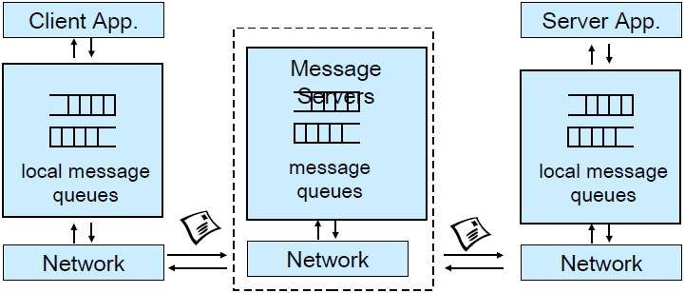
Message-Oriented Middleware (MOM)
Communication using messages
Messages stored in message queues
message servers decouple client and server
Various assumptions about message content
Properties of MOM
Asynchronous interaction
Client and server are only loosely coupled
Messages are queued
Good for application integration
Support for reliable delivery service
Keep queues in persistent storage
Processing of messages by intermediate message server(s)
May do filtering, transforming, logging, …
Networks of message servers
Natural for database integration

Slide 22
Message-Oriented Middleware (MOM)
IBM MQ-Series
One-to-one reliable message passing using queues
Persistent and non-persistent messages
Message priorities, message notification
Queue Managers
Responsible for queues
Transfer messages from input to output queues
Keep routing tables
Message Channels
Reliable connections between queue managers
Java Messaging Service (JMS)
API specification to access MOM implementations
Two modes of operation *specified*:
Point-to-point: one-to-one communication using queues
Publish/Subscribe: Event-Based Middleware
JMS Server implements JMS API
JMS Clients connect to JMS servers
Java objects can be serialised to JMS messages
A JMS interface has been provided for MQ
pub/sub (one-to-many) - just a specification?

Slide 23
MOM - Disadvantages
Poor programming abstraction (but has evolved)
Rather low-level (cf. Packets)
Request/reply more difficult to achieve, but can be done
Message formats originally unknown to middleware
No type checking (JMS addresses this – implementation?)
Queue abstraction only gives one-to-one communication
Limits scalability (JMS pub/sub – implementation?)

Slide 24
Web Services
Use well-known web standards for distributed computing
Communication
Message content expressed in XML
Simple Object Access Protocol (SOAP)
Lightweight protocol for sync/async communication
Service Description
Web Services Description Language (WSDL)
Interface description for web services
Service Discovery
Universal Description Discovery and
Integration (UDDI)
Directory with web service description in WSDL
Properties of Web Services
Language-independent and open standard
SOAP offers OOM and MOM-style communication:
Synchronous request/reply like OOM
Asynchronous messaging like MOM
Supports internet transports (http, smtp,
...)
Uses XML Schema for marshalling types to/from programming language types
WSDL says how to use a web service
http://api.google.com/Google Search.wsdl
UDDI helps to find the right web service
Exports SOAP API for access

Slide 25
Web Services
Disadvantages of WS
Low-level abstraction
leaves a lot to be implemented
Interaction patterns have to be built
one-to-one and request-reply provided
one-to-many?
still synchronous service invocation, rather than notification
No nested/grouped invocations,
transactions, ...
No location transparency
What we lack so far ?
General interaction patterns
we have one-to-one and request-reply
one-to-many? many to many?
notification?
dynamic joining and leaving?
Location transparency
anonymity of communicating entities
Support for pervasive computing
data values from sensors
lightweight software

Slide 26
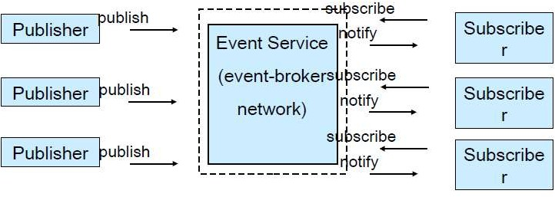
Event-Based Middleware a.k .a. Publish/Subscribe
Publishers (advertise and) publish events (messages)
Subscribers express interest in events with subscriptions
Event Service notifies interested subscribers of published events
Events can have arbitrary content (typed) or name/value pairs

Slide 27
Topic-Based and Content-Based Pub/Sub
Event Service matches events against subscriptions
What do subscriptions look like?
Topic-Based Publish/Subscribe
Properties of Pub/Sub
Asynchronous communication
Publishers and subscribers are loosely
coupled
Publishers publish events belonging to a ➢ Many-to-many interaction between pubs.
topic or subject
Subscribers subscribe to a topic subscribe(PrintJobFinishedTopic, …)
(Topic and) Content-Based Publish/Subscribe
Publishers publish events belonging to topics and
Subscribers provide a filter based on content of events subscribe(type=printjobfinished,
printer=‘aspen’, …)
and subs.
Scalable scheme for large-scale systems
Publishers do not need to know subscribers, and vice-versa
Dynamic join and leave of pubs, subs,
(Topic and) Content-based pub/sub very expressive
Filtered information delivered only to interested parties
Efficient content-based routing through a broker network

